Slide 1
NETW211 Course Projects Jan 23 – Prof Giomi Christopher Hill

Slide 2
Module 2 Virtual Machine (VM) Instances

Slide 3
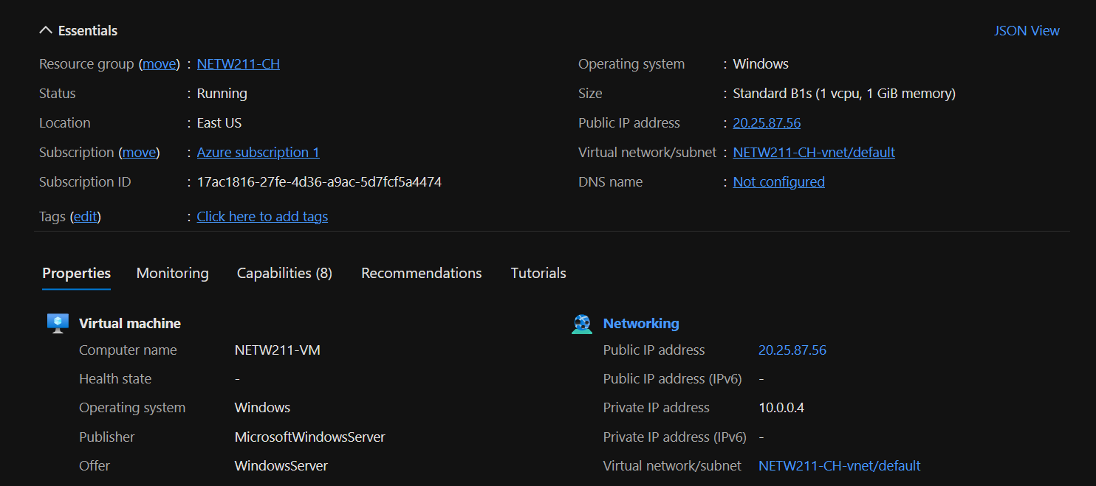
Deploying a VM in Azure
This screenshot should show the NETW211VM page with information such as the resource group name, subscription, public IP address, etc.

Slide 4
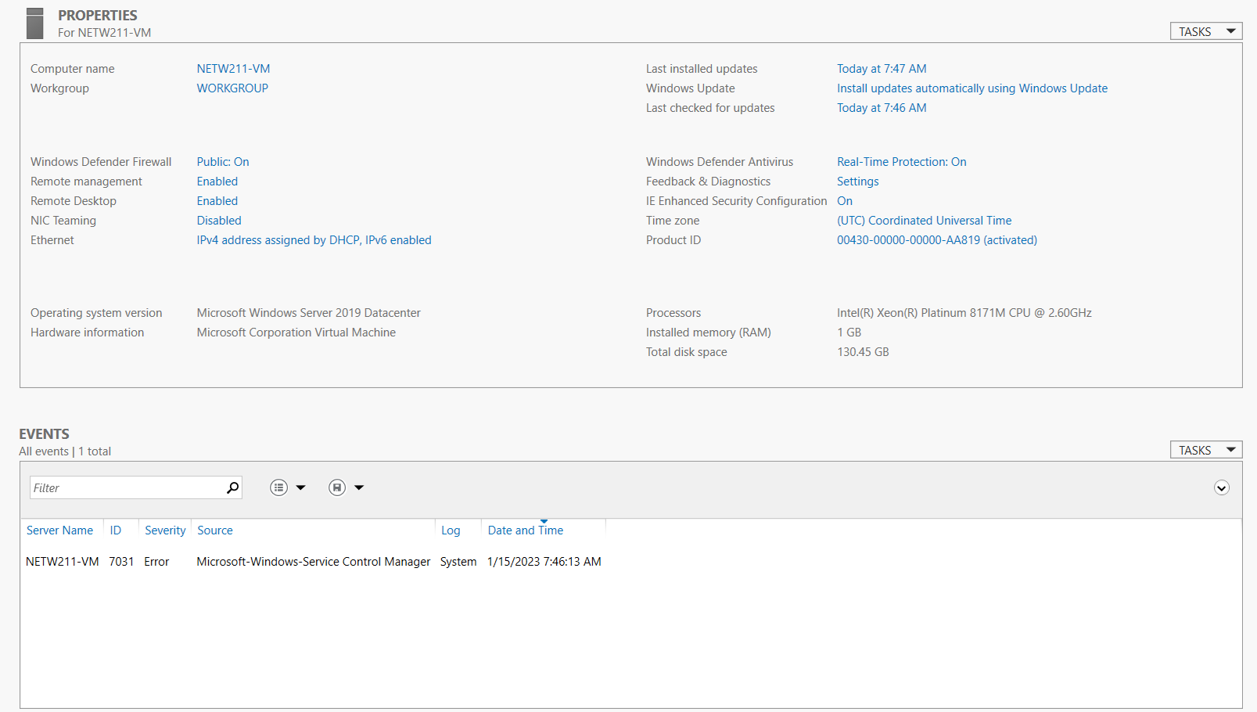
Connecting to the VM
This screenshot should show the PROPERTIES for NETW211VM page, with the computer name, operating system version, hardware information, etc.

Slide 5
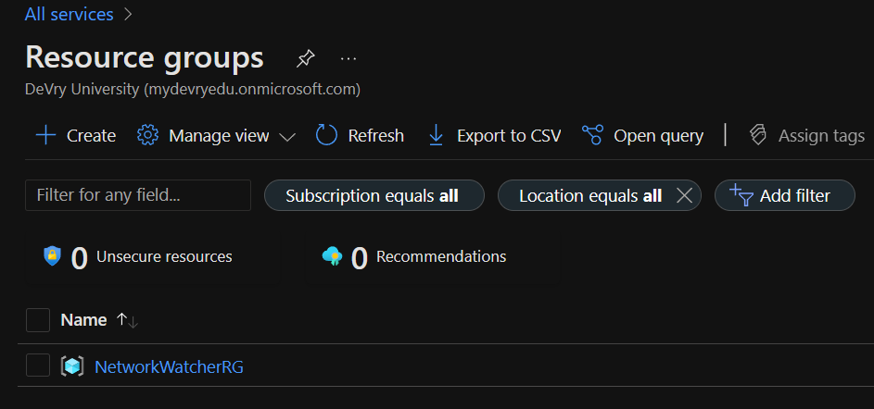
Deleting
the VM
This screenshot should show the Resource groups page, with the Azure for Students subscription selection and the “No resource groups to display” message.

Slide 6
Module 3 Azure VNet and Subnets

Slide 7
Creating a VNet with Two Subnets
1. With a /24 network prefix, how many usable IPv4 host addresses are there? [hint: you learned this in NETW191]
Answer here: 254
2. Given the answer above, why is the number of available IP addresses for Subnet0 (10.0.0.0/24) or Subnet1 (10.0.1.0/24) shown as 251? [hint: where did the missing addresses go?]
Answer here: Azure reserves the first 3 subnets
References (here are two examples to get your research started):
1. IP Subnet Calculator, https://www.calculator.net/ip-subnet-calculator.html
2. Azure Virtual Network frequently asked questions, https://docs.microsoft.com/en-us/azure/virtual-network/virtual-networks-faq

Slide 8
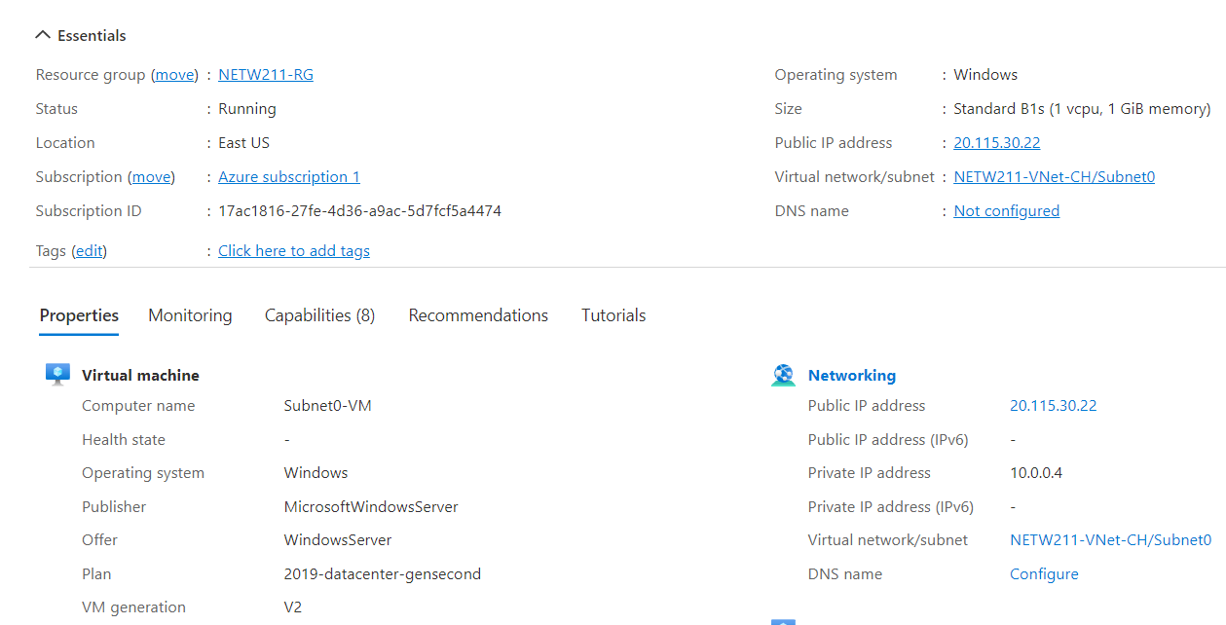
Deploying VMs into Subnets
This screenshot should show the Properties section of the Subnet0-VM page, showing the networking and size information of the VM.

Slide 9
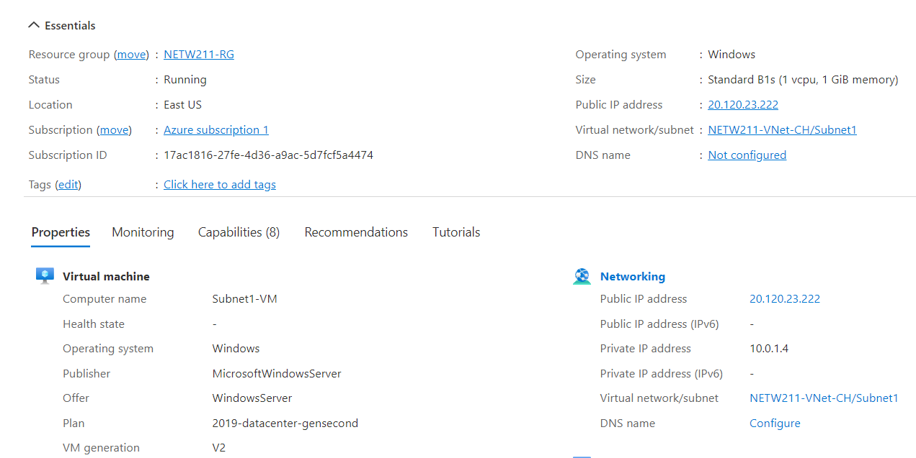
Deploying VMs into Subnets cont’d
This screenshot should show the Properties section of the Subnet1-VM page, showing the networking and size information of the VM.

Slide 10
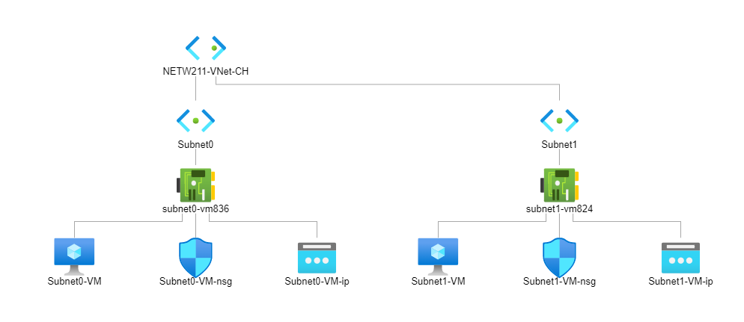
Deploying VMs into Subnets cont’d
This screenshot should show the topology diagram of your VNet (NETW211-VNet-Your Initials) with two subnets (Subnet0 and Subnet1) and one VM in each subnet (Subnet0-VM and Subnet1-VM).

Slide 11
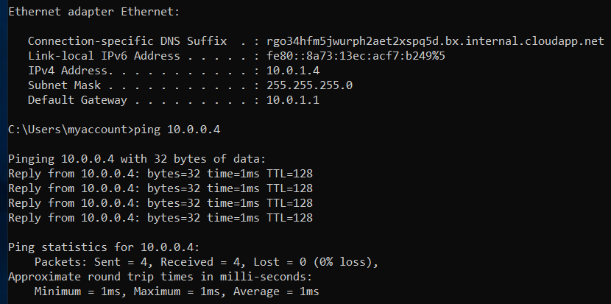
Verifying Connectivity between VMs
This screenshot should show the ipconfig and ping x.x.x.x results in the command prompt window, including the Subnet0-VM – x.x.x.x – Romote Desktop Connection window title.

Slide 12
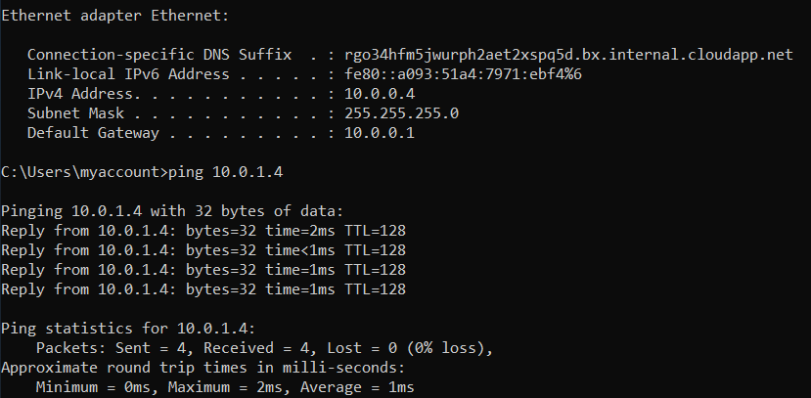
Verifying Connectivity between VMs
cont’d
This screenshot should show the ipconfig and ping x.x.x.x results in the command prompt window, including the Subnet1-VM – x.x.x.x – Romote Desktop Connection window title.

Slide 13
Module 4 Azure VM Security

Slide 14
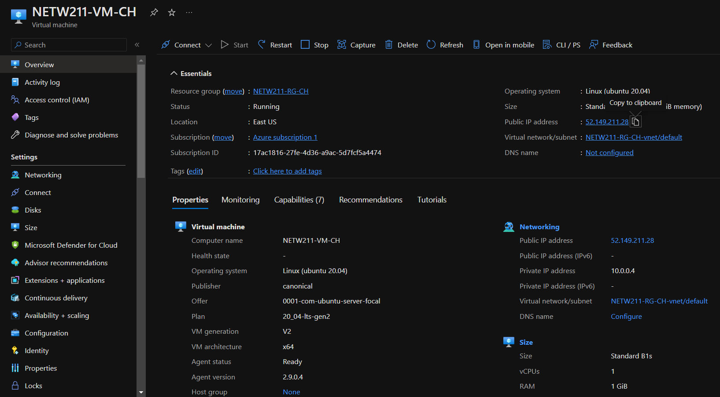
Launching a VM
This screenshot should show the NETW211-VM-Your Initials page, with information such as the resource group name, subscription, public IP address, etc.

Slide 15
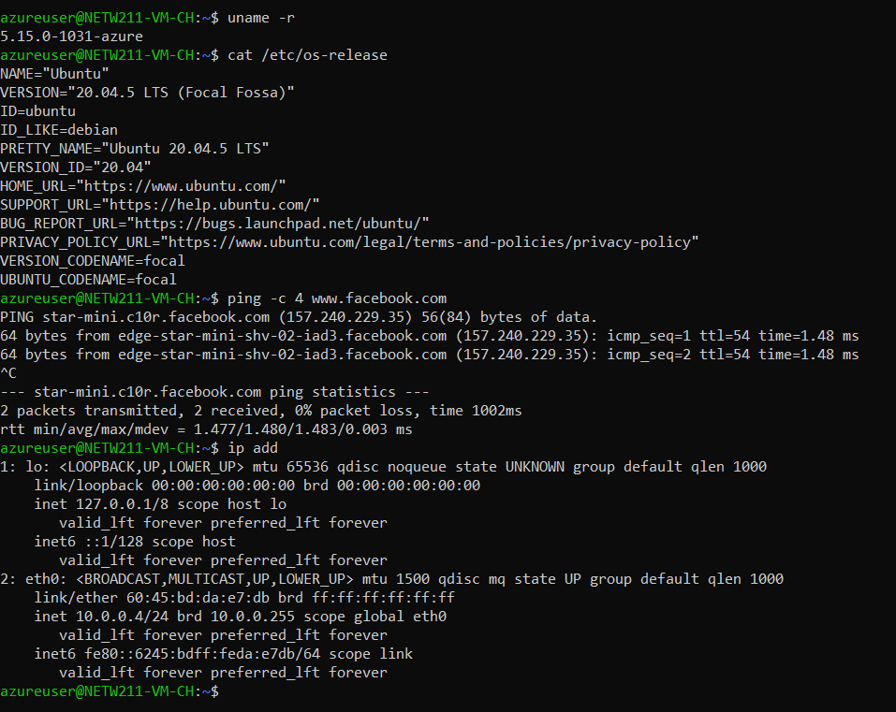
Connecting to the VM
via SSH
This screenshot should show the azureuser@NETW211-VM-Your Initials window showing the IPv4 address of the VM in the Azure cloud.

Slide 16
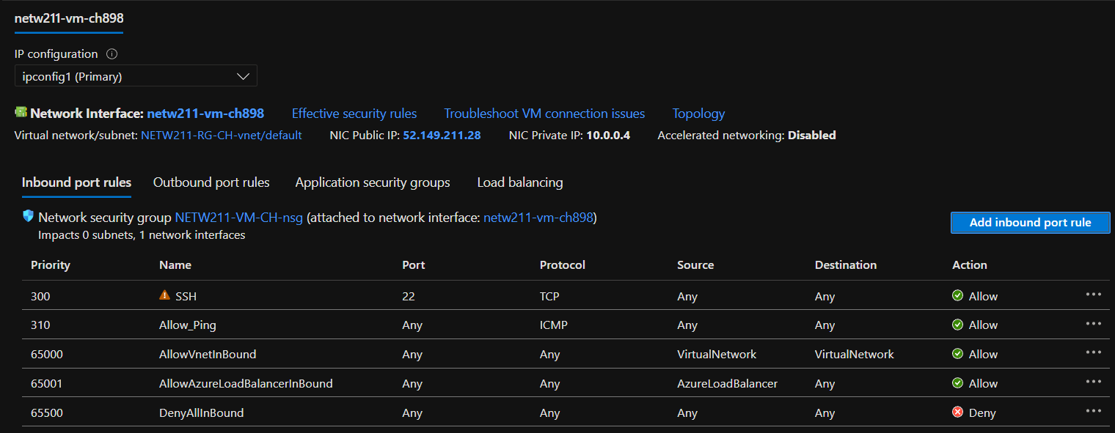
Configuring an NSG
This screenshot should show the Inbound port rules section with the newly added Allow_Ping rule.

Slide 17
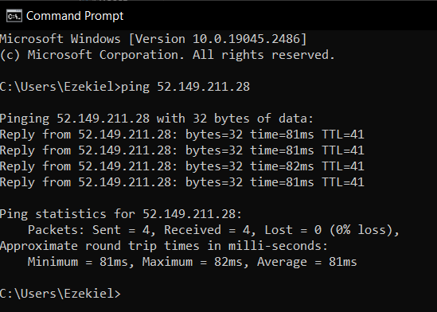
Configuring an NSG
cont’d
This screenshot should show the successful ping result from your local computer to the VM in the Azure cloud.

Slide 18
Module 5 Cloud Storage

Slide 19
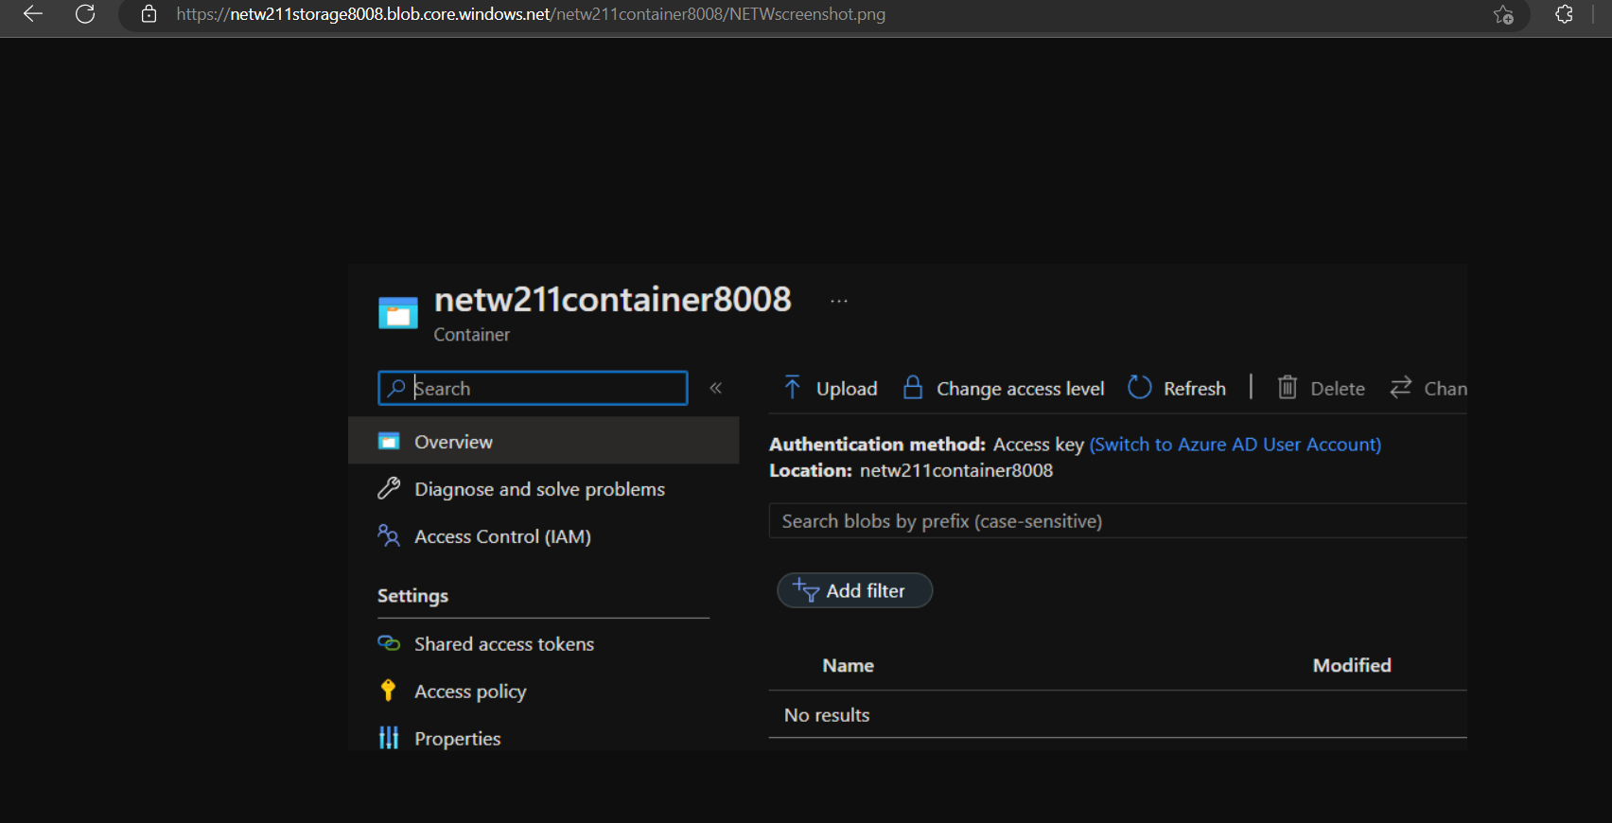
Uploading and Accessing a File
This screenshot should show the browser window with the image uploaded from your local computer and the URL on top of the window.

Slide 20
Question
What does the access tier setting do? What are the Azure blob storage access tiers?
[hint: in the Azure portal, on the Upload blob page, under Advanced, click the ? circle above the Access tier box.]
Answer here:
Hot tier - An online tier optimized for storing data that is accessed or modified frequently. The hot tier has the highest storage costs, but the lowest access costs.
Cool tier - An online tier optimized for storing data that is infrequently accessed or modified. Data in the cool tier should be stored for a minimum of 30 days. The cool tier has lower storage costs and higher access costs compared to the hot tier.
Archive tier - An offline tier optimized for storing data that is rarely accessed, and that has flexible latency requirements, on the order of hours. Data in the archive tier should be stored for a minimum of 180 days.
References (here are two examples to get your research started):
1. Hot, Cool, and Archive access tiers for blob data, https://docs.microsoft.com/en-us/azure/storage/blobs/access-tiers-overview
2. Azure Blob Storage Access Tiers, https://devry.percipio.com/courses/c7ef0333-8560-403f-a004-9c5c843866b0/videos/2658bbe6-ee97-438b-a376-fbb079c3b3a0

Slide 21
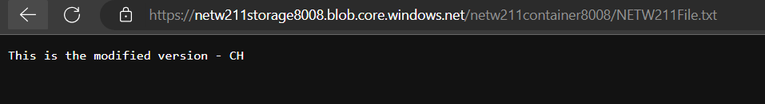
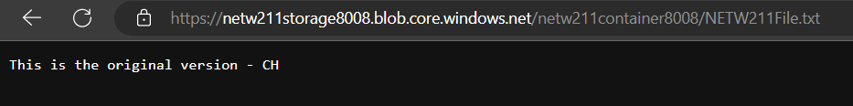
Creating Blob Snapshots
This screenshot should show the browser window with the “This is the original version. –Your Initials” message and the URL on top of the window

Slide 22
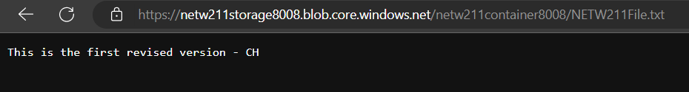
Enabling Blob Versioning
This screenshot should show the browser window with the “This is the first revised version. –Your Initials” message and the URL on top of the window.

Slide 23
Module 6 Cloud Monitoring

Slide 24
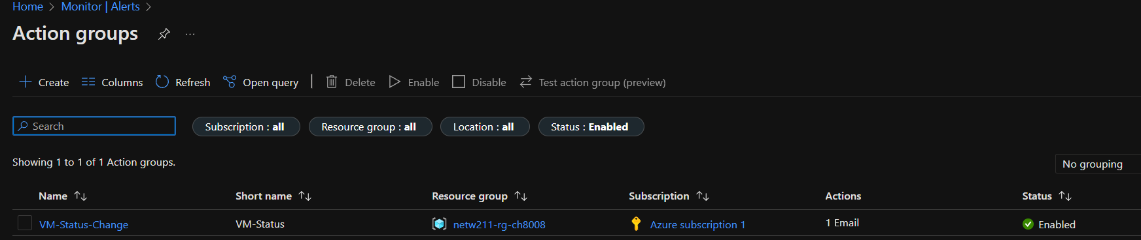
Setting up an Action Group and Notifications
This screenshot should show the “VM-Status-Change” action group on the Manage actions page.

Slide 25
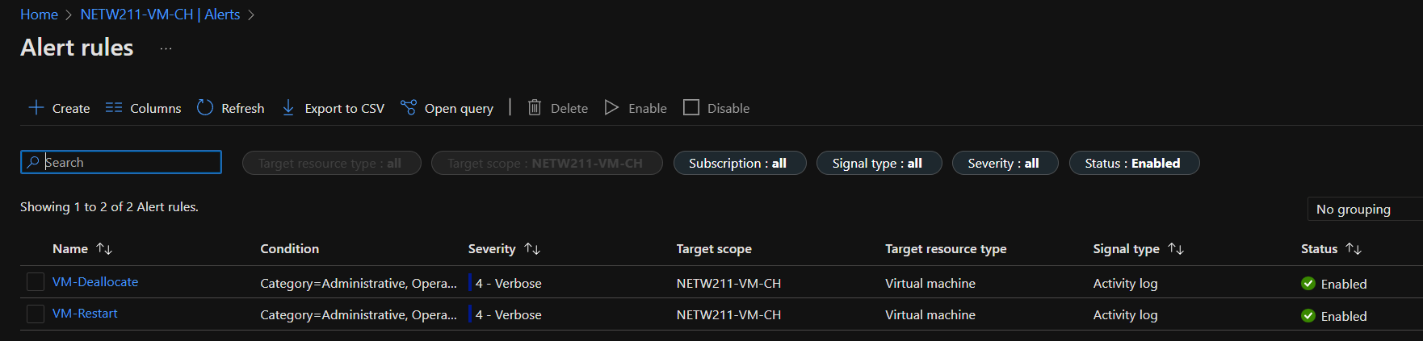
Setting up Alert Rules
This screenshot should show the Alert rules window showing the VM-Deallocate and VM-Restart rules.

Slide 26
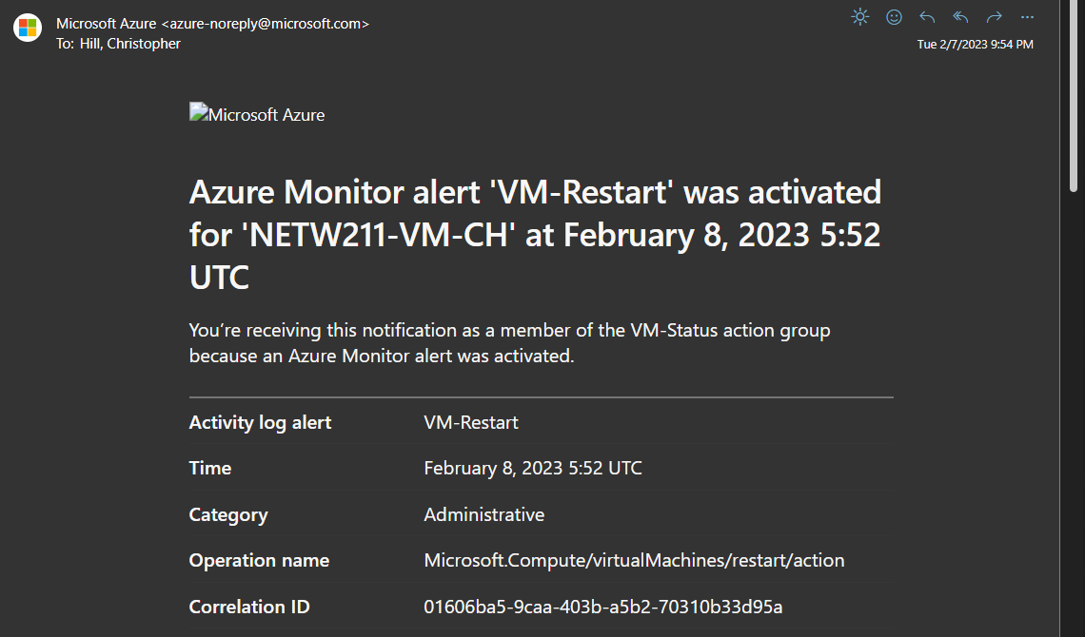
Testing Alerts
This screenshot should show the ‘VM-Restart’ was activated email message with the date and time of the alert.

Slide 27
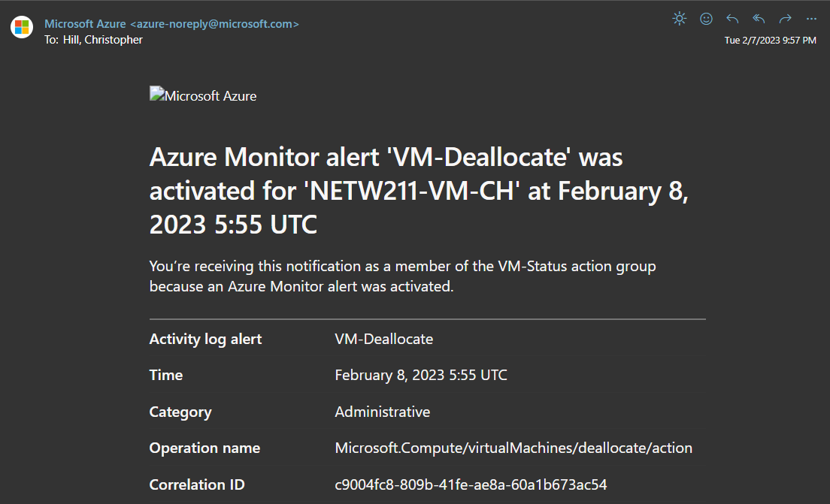
Testing Alerts cont’d
This screenshot should show the ‘VM-Deallocate’ was activated email message with the date and time of the alert.

